Slide 1
National Conference
Planning Committee
May 17, 2018 Meeting

Slide 2
Meeting Agenda
1. Discuss keynote ranking survey results (18 responses)
2. Refine keynote speaker list
3. Recruit proposal graders
4. Other

Slide 3
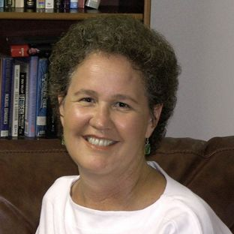
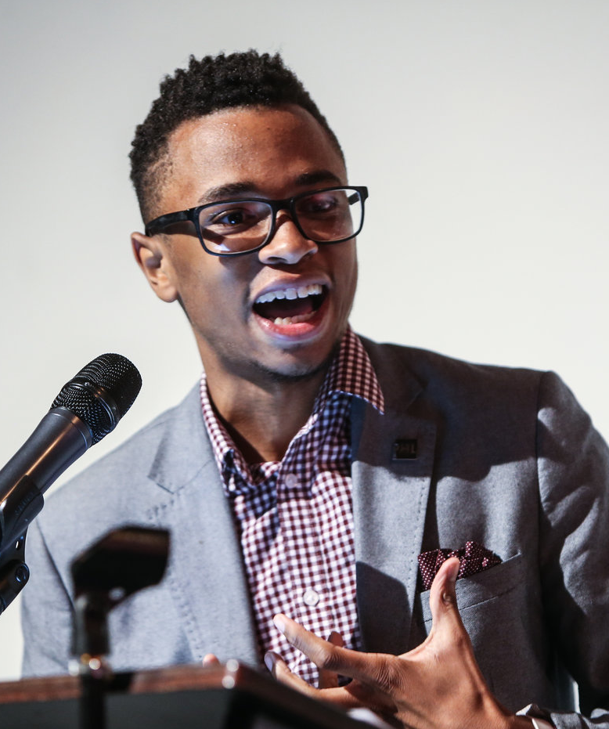
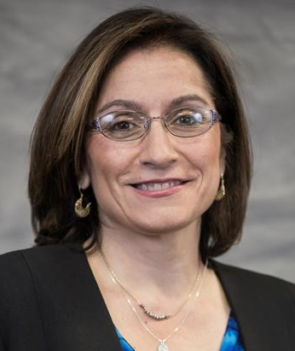
Keynotes Survey Results
Which speaker best represents INTEGRATE?
Linda Darling-Hammond
  (9 votes) 50%
Tamir Harper & Susan Cordova (7 votes each) 38.9%
Neil deGrasse Tyson
  (6 votes) 33.3%
Jessica Solano & Horacio Sanchez
  (5 votes each) 27.8%
Linda Darling-Hammond
Tamir Harper
Susan Cordova

Slide 4
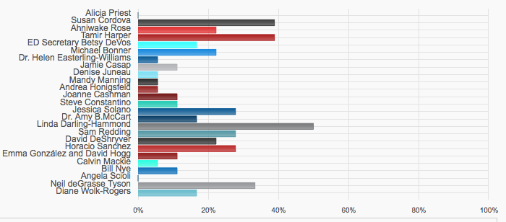
Keynotes Survey Results
Which speaker best represents INTEGRATE?

Slide 5
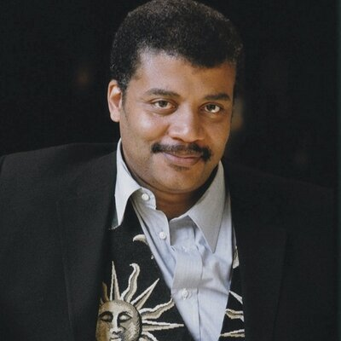
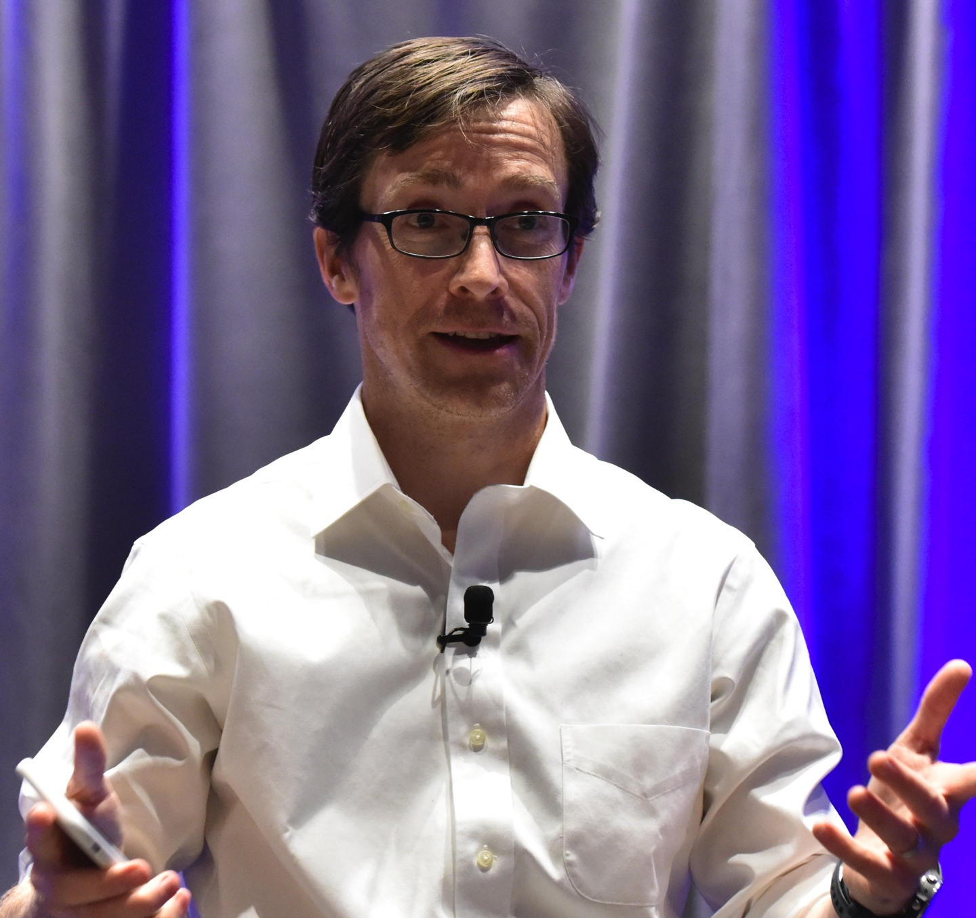
Keynotes Survey Results
Which speaker best represents INNOVATE?
Neil deGrasse Tyson
(8 votes) 44.4%
David DeShryver
  (6 votes) 33.3%
Jessica Solano & Tamir Harper (5 votes each) 27.8%
Betsy DeVos, Sam Redding, Linda Darling-Hammond & Michael Bonner
  (4 votes each) 22.2%
Neil deGrasse Tyson
David DeShryver

Slide 6
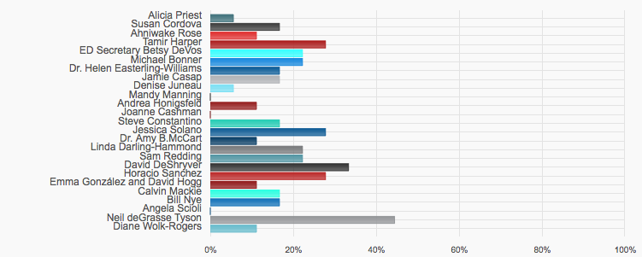
Keynotes Survey Results
Which speaker best represents INNOVATE?

Slide 7
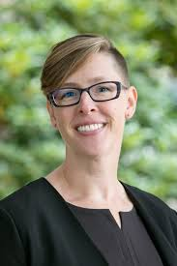
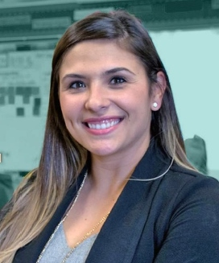
Keynotes Survey Results
Which speaker best represents COLLABORATE?
Linda Darling-Hammond
(7 votes) 38.9%
Mandy Manning &
  Jessica Solano
  (5 votes each) 27.8%
Diane Wolk-Rogers, Horacio Sanchez, Sam Redding, Steve Constantino, Emma González & David Hogg, Jamie Casap, and Michael Bonner
  (4 votes each) 22.2%
Linda Darling-Hammond
Mandy Manning
Jessica Solano

Slide 8
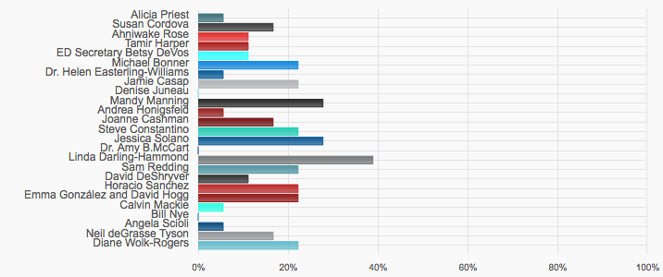
Keynotes Survey Results
Which speaker best represents COLLABORATE?

Slide 9
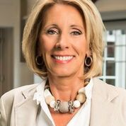
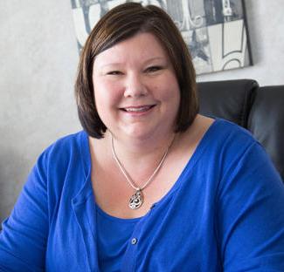
Keynotes Survey Results
Which speakers are you least interested in?
Betsy DeVos (9 votes) 50%
Alicia Priest (8 votes) 44.4%
Emma González & David Hogg (5 votes) 27.8%
Diane Wolk-Rogers(4 votes) 22.2%
Sam Redding(4 votes) 22.2%
Ahniwake Rose(4 votes) 22.2%
Bill Nye(4 votes) 22.2%
Jamie Casap(4 votes) 22.2%
Betsy DeVos
Alicia Priest

Slide 10
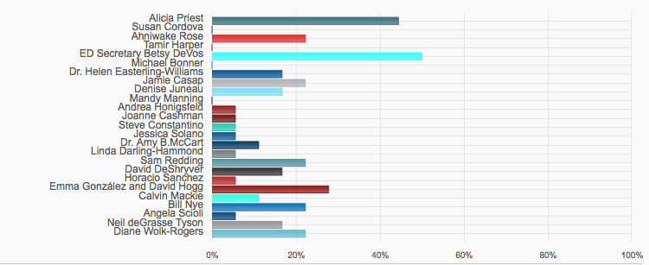
Keynotes Survey Results
Which speakers are you least interested in?

Slide 11
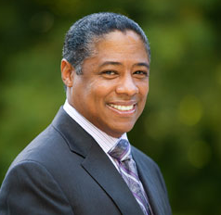
Keynotes Survey Results
Select the top 6 speakers you would be most excited to have at the Conference.
Linda Darling-Hammond (11 votes) 61.1%
Neil deGrasse Tyson
(10 votes) 55.6%
3. Horacio Sanchez
  (8 votes) 44.4%
4. Mandy Manning
(7 votes) 38.9%
3-Way Tie for 5 & 6:
Michael Bonner (6 votes) 33.3%
Tamir Harper(6 votes) 33.3%
Susan Cordova (6 votes) 33.3%
Neil deGrasse Tyson (1) 7.7%
Linda Darling-Hammond
Neil deGrasse Tyson
Horacio Sanchez

Slide 12
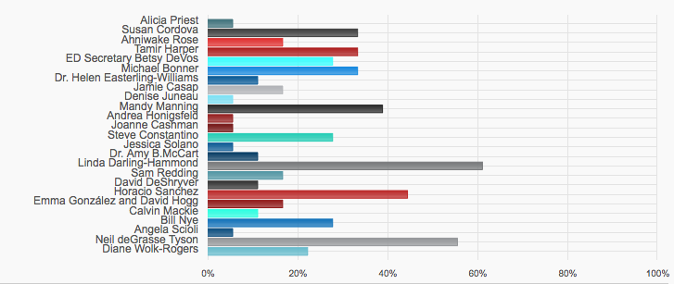
Keynotes Survey Results
Select the top 6 speakers you would be most excited to have at the Conference.

Slide 13
Refine keynote speaker list
“America has voted” (well, actually the NCPC).
“The results are in.”
We are narrowing the field of keynotes to the “Top 12.”
Which thirteen candidates will be “going home?”

Slide 14
Recruit proposal graders
Automatic Graders:
  All National Conference Planning Committee Members
Invited:
  2017 Distinguished School Principals
Asked or otherwise coerced:
  Other Association members

Slide 15
Grading Proposals
Opens June 29
Closes July 8
All grading takes place online through your www.ESEAnetwork.org account

Slide 16
Next Committee Meeting
July 25 at the 2018 NAESPA Summer Meeting in Washington DC
Register now for the Summer Meeting

