Slide 1

National Title I
Conference Planning Committee
June 20, 2012
CONTENT DECISIONS

Slide 2
Proposal Review Process
Who will grade?
Likely number of Proposals
Notes:
Conversation Talking Points:
Discuss expanding the number of graders through a call to members to participate
Over 221 proposals submitted as of 6/14/12 and we expect between 300-400 or more by June 30 deadline
Benefits: Increase participation, fewer number of proposals for each grader, more grades per proposal
Goal:
Decide whether to open the grading process to all association members

Slide 3
PROPOSAL REVIEW PROCESS
    Online Process
Notes:
Conversation Talking Points:
Graders complete work online by accessing website
Graders will use a rubric to provide consistency
Each grader will be assigned approximately 50 proposals randomly
Estimated time – approximately 7 hours
Remind the committee that this initial grading process will help facilitate final presentation selections at the August meeting. The number of proposals needing to be considered will be more manageable.
Goal: Affirm support for the grading process

Slide 4
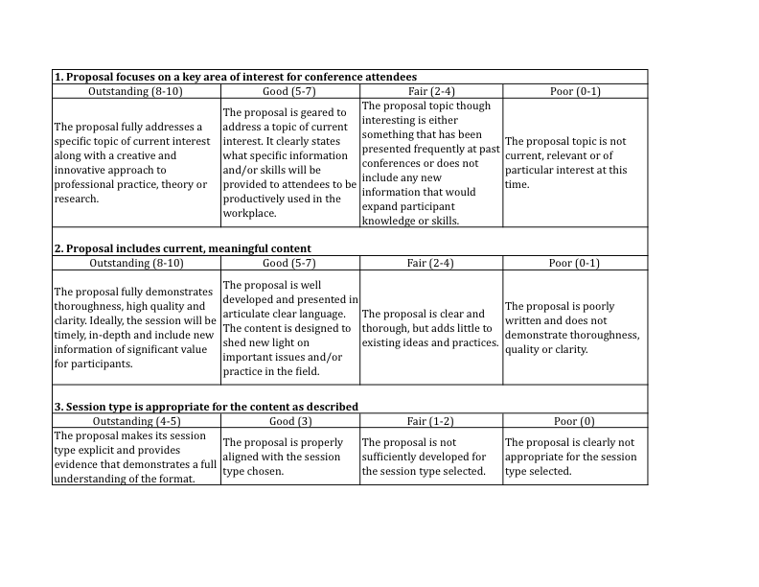
PROPOSAL REVIEW PROCESS
Notes:
Conversation Talking Points:
Use of Rubric for consistency
Rubric will help to make grading process more consistent, provides graders with specific criteria to complete the proposal review process
Goal:
Decide whether to use the proposed Rubric – any suggested changes?

Slide 5
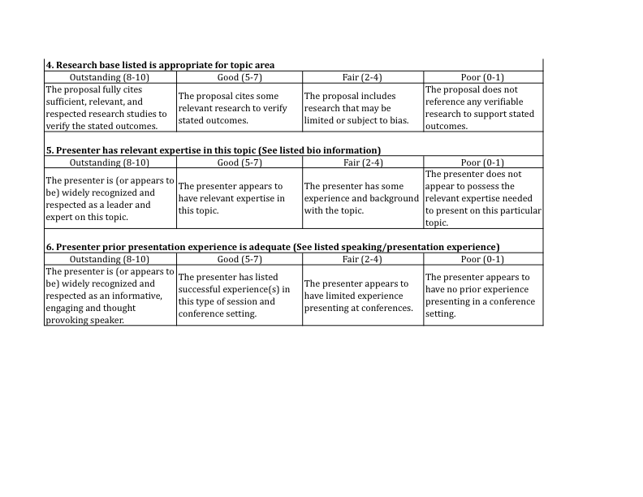

Slide 6
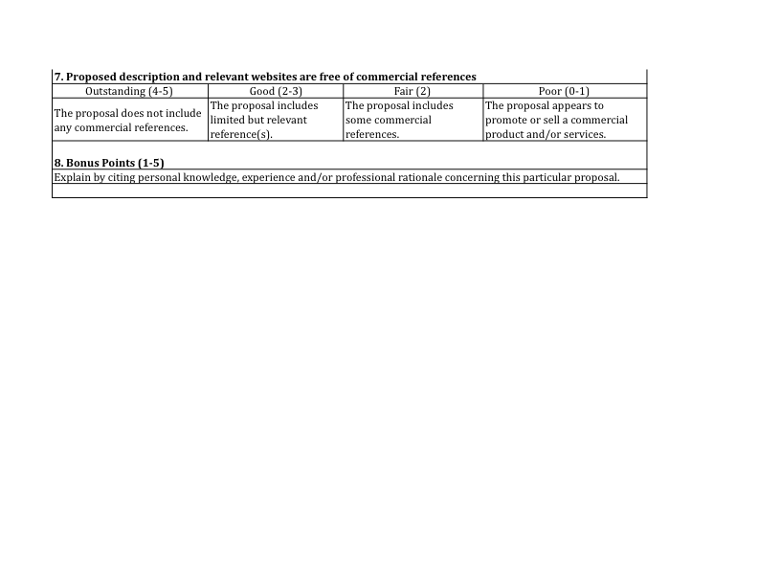

Slide 7
PROPOSAL REVIEW PROCESS
    Timeline
      June 26: Call for Graders
      June 30: Proposal Submission Deadline
      July 12: Grading Instructions Sent
      July 14-22: Proposal Grading
Notes:
Conversation Talking Points:
Simply review dates
Goal:
1. Review timeline

Slide 8
KEYNOTE SPEAKERS OVERVIEW
Four (4) Keynote Speakers – One per day
Types – Inspirational, Controversial/Thought Provoking?
Process to identify Potential Keynotes
  Committee ranks all suggestions received via online survey
  Timeline
    June 30 – July 13: Survey completed
    July 18 – Finalize Keynote Sessions
Notes:
Conversation Talking Points:
Discuss the kinds of keynotes desired – what is goal of these sessions?
Discuss the suggested process and timelines to review potential keynote sessions.
Goal:
Confirm keynote session structure, types, and timeline

Slide 9
NEXT STEPS
July 18 Meeting - same time and place
    Keynote speaker decision

