Slide 1
National Title I
Conference Planning Committee
July 18, 2012
KEYNOTE SPEAKERS

Slide 2
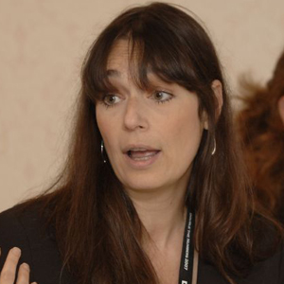
DEBORAH BIAL
The Posse Foundation –
A Tool for Success
Founder of the Posse Foundation, dedicated to supporting groups of multi-cultural student leaders who are intensively prepared for college success. Many college leaders feel that the posse concept ensures diverse student representation and participation in the college experience. The organization has representative partners throughout the United States to provide a high quality college opportunity to underserved groups of students. She can speak to the topic- The Politics of Race and Class in Higher Education. President Obama donated a portion of his Nobel Peace Prize award to the Posse Foundation.
Notes:
Discussion Points: Pro’s and Con’s for DEBORAH BIAL

Slide 3
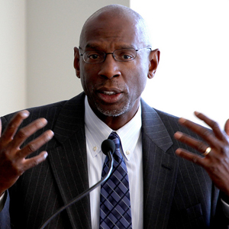
GEOFFREY CANADA Harlem's Children Zone
Canada is an American social activist, educator and Founder of the Harlem’s Children’s Zone. Has received significant recognition for his work and has appeared in the media many times including 60 minutes and Oprah. He also is a published author and his work is being used as a model in other areas of the country for the expansion of educational opportunities for undeserved children and to increase high school and graduation rates for students in Harlem.
Notes:
Discussion Points: Pro’s and Con’s GEOFFREY CANADA

Slide 4
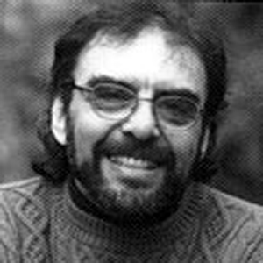
GERALD COLES Why Bother Educating the Poor? Are education reforms making a difference in the lives of poor students? Or are they a charade?
Mr. Coles is a full-time researcher, writer, and lecturer on the psychology and politics of literacy and education. He is the author of several books, including: Reading the Naked truth: Literacy, Legislation and Lies, as well as numerous articles in education, psychology and psychiatry journals. He is an active member of the Coalition got Justice in Education in Rochester NY.
Notes:
Discussion Points: Pro’s and Con’s GERALD COLES

Slide 5
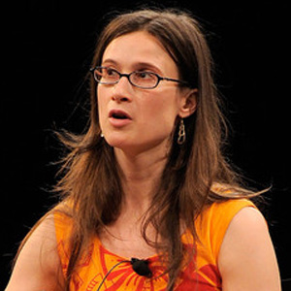
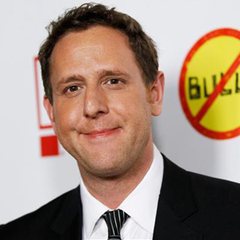
CYNTHIA LOWEN LEE HIRSH “Bully” Movie
This film has received much notoriety recently and the director has involved students from throughout the country through special showings and discussion. This is a relevant and important topic for all school staff, students and parents to consider and address through meaningful dialogue. We would envision a similar format and conversation with the director as the one used last year with “Waiting for Superman”.
Notes:
Discussion Points: Pro’s and Con’s on LEE HIRSH and CYNTHIA LOWEN

Slide 6
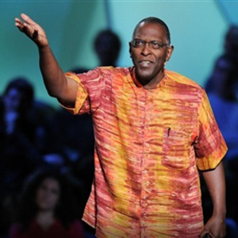
JOHN HUNTER "Real World" Learning
Fourth grade teacher who created the “World Peace Project” John puts all the problem of the world on a 4 x 5 plywood board - let’s his 4th graders solve them. He explains how this activity engages kids and why the complex lessons it teaches, spontaneous and always surprising - go further than classroom lectures can.
Notes:
Discussion Points: Pro’s and Con’s on JOHN HUNTER

Slide 7
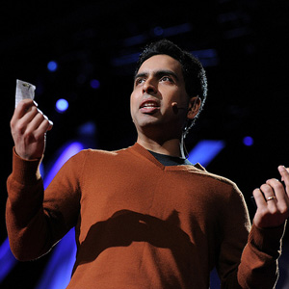
SALMAN KAHN Kahn Learning Academy
As the creator of the Kahn Academy he can share his story of invention and how the application of on-line, anytime access to educational content has the potential to dramatically change how we conduct and view schooling. The concept of “flipping” comes to mind in that a teacher can assign work before or after a specific lesson to further deepen student understanding and mastery of a particular concept. The timely issue of “personalized learning” is imbedded in his work. The implications for students who struggle with content, use and access to technology could also be part of the presentation.
Notes:
Discussion Points: Pro’s and Con’s on SALMAN KAHN

Slide 8
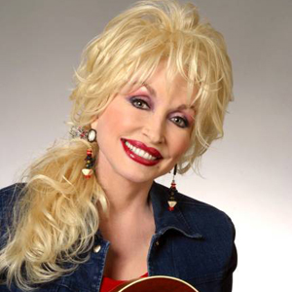
DOLLY PARTON Imagination Library
In 1996, Dolly Parton launched an exciting new effort, Dolly Parton’s Imagination Library, to benefit the children of her home county in East Tennessee. Her vision was to foster a love of reading among her counties preschool children and their families by providing them with a specially selected book each month. This idea became so popular that in the year 2000 she announced that she would make the program available to any community that was willing to partner with her to support it locally. This effort has gone from a few dozen books to nearly 40,000,000 books being sent to children in the US, Canada and the United Kingdom. Currently over 1600 local communities provide the Imagination Library to almost 700,000 children each month. Already statistics and independent reports have shown that this program is having a positive impact on childhood literacy for those children enrolled in the program.
Notes:
Discussion Points: Pro’s and Con’s on DOLLY PARTON

Slide 9
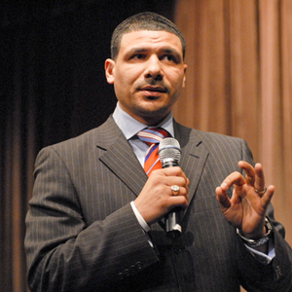
DR. STEVE PERRY Transformative Change In Our Schools
Dr. Perry is a hurry to transform educational experiences for all children. Born into poverty, he believes that success in life is determined by where you end, not where you start. In 1998 he founded ConnCAP, the Connecticut Collegiate Awareness Program at Capital Community College, in it’s first six years this program sent 100% of its low-income first generation graduates to four-year colleges. Following this success the Capital Preparatory Magnet School was established and since its inception it too has sent 100% of its graduates to four-year colleges. Capital Prep has been recognized by US News and World Report as one of America’s best high schools. Dr. Perry’s uncompromising, no-excuses approach to designing the ideal educational experience for children led to his being featured on CNN, Anderson Cooper 360 and American Morning. He is a columnist for Essence Magazine and the author of the best selling published book Man Up! He spares no sacred cows in describing what steps must be taken to ensure that all American schools deliver a first rate education to ALL students.
Notes:
Discussion Points: Pro’s and Con’s on DR. STEVE PERRY

Slide 10
Rank Individual Speakers
_____
DEBORAH BIAL
_____
JOHN HUNTER
GEOFFREY CANADA
_____
_____
SALMAN KAHN
_____
GERALD COLES
_____
DOLLY PARTON
_____
DR. STEVE PERRY
_____
CYNTHIA LOWEN & LEE HIRSH
Notes:
Discussion Points: Rank all individuals from 1-8 (1 being the best, 8 is the least favorite)

